Slide 1

DEPARTMENT OF ARITIFICIAL INTELLIGENCE AND DATA SCIENCE ACADEMIC YEAR 2025 - 2026 SEMESTER III ARTIFICIAL INTELLIGENCE LABORATORY MINI PROJECT REVIEW Parking Slot Finder Application Using BFS Algorithm
REGISTER NUMBER | 2117240070169
NAME | LOHITH.R
YEAR | II
SECTION | C
FACULTY IN-CHARGE | Ms. Phebe Persis

Slide 2
PROBLEM STATEMENT
PROBLEM STATEMENT: This project models a parking lot as a 2D grid, where each cell represents a parking space. The AI agent must navigate from the entry point 'I' to the nearest empty slot 'E' using BFS.
Expected Results:
BFS identifies the shortest and most efficient path to an empty slot.
The system marks the slot as occupied once parked.
Future Possibilities:
Add multiple entry points and dynamic slot updates.
Extend with A* Search or integrate a graphical interface using Tkinter or Pygame.
Include real-time sensors and IoT integration for live parking data.

Slide 3
THEORETICAL BACKGROUND
Depth-First Search (DFS):
Explores deep paths first.
May not find the shortest path in a grid.
Breadth-First Search (BFS):
Explores level by level.
Guarantees the shortest path in unweighted grids.
Dijkstra / A Search:*
Designed for weighted graphs.
Not required for this project since all moves are equal.
Justification for Choosing BFS:
The parking lot is modeled as an unweighted grid.
BFS ensures the shortest path to the nearest empty slot.
DFS may explore unnecessary paths or miss optimal solutions.
Weighted algorithms are unnecessary for equal-cost movements.

Slide 4
THEORETICAL BACKGROUND
System Overview
The project simulates a Smart Parking Management System that identifies the nearest available parking slot from an entrance using the Breadth-First Search (BFS) algorithm.
The parking lot is modeled as a 10×10 grid, where:
‘I’ → Entry point
‘E’ → Empty parking slot
‘X’ → Occupied or blocked area
‘O’ → Open path
The BFS algorithm systematically explores the grid level by level from the entry point to locate the nearest free slot. Once a slot is found, it is marked as occupied to simulate a vehicle being parked.
A car removal feature allows users to free a slot and make it available again.
The system provides a simple menu-driven interface that enables users to:
Find the nearest parking slot
Remove a parked car
Exit the program
By using BFS, the system ensures the shortest and most efficient route to the nearest available slot while avoiding blocked cells.

Slide 5
IMPLEMENTATION AND CODE
Link to the code and report in Git-hub Repository:
List | Git-hub Repository Links
Implementation of Code Link | https://github.com/Lohith156/Parking-slot-finder.git
Word Document Report Link | https://github.com/Lohith156/Parking-slot-finder.git
PPT Link | https://github.com/Lohith156/Parking-slot-finder.git

Slide 6
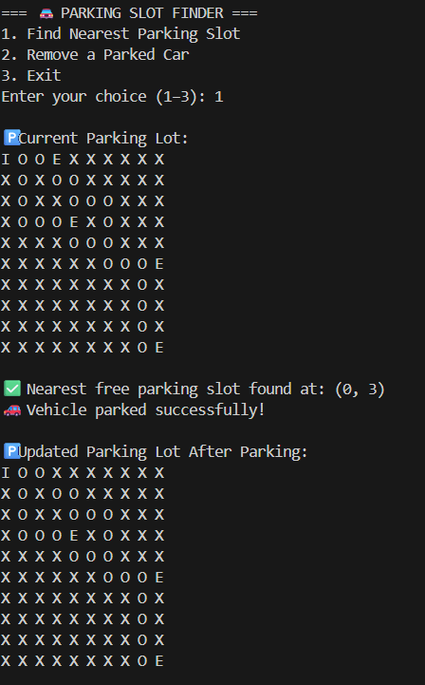

OUTPUT AND RESULTS

Slide 7
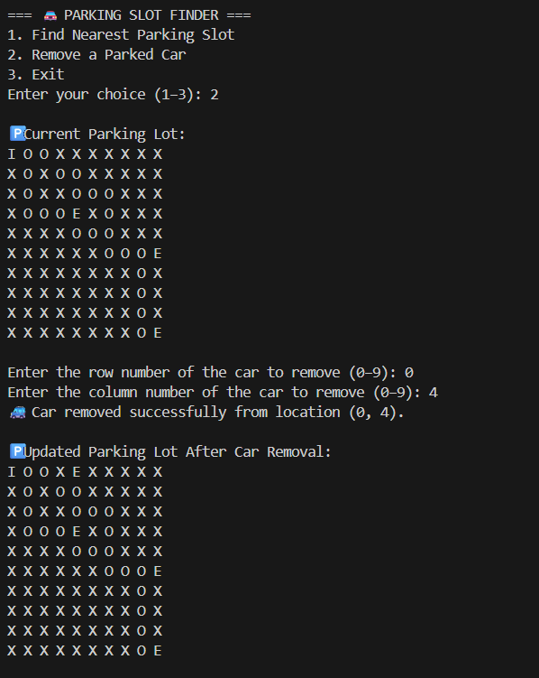
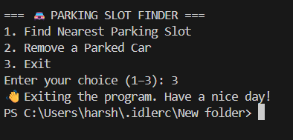
OUTPUT AND RESULTS

Slide 8
REFERENCES
GeeksforGeeks — Breadth First Search (BFS) Algorithm in Python 🔗 https://www.geeksforgeeks.org/breadth-first-search-or-bfs-for-a-graph/
Python Software Foundation — Python 3 Official Documentation 🔗 https://docs.python.org/3/
Real Python — Python BFS and Queue Implementations 🔗 https://realpython.com/
TutorialsPoint — Python Functions and Control Structures 🔗 https://www.tutorialspoint.com/python/
Medium (Towards Data Science) — Understanding Breadth-First Search in Graph Theory 🔗 https://towardsdatascience.com/

